Slide 1
!S3. Dynamic Malware Detection using Network Traffic Analysis
Aishwarya Thirumalai
Francis Orumwense
Pragnya Manaswini

Slide 2
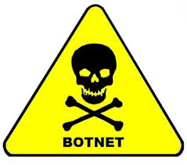

Introduction
Bots are one of the most sophisticated and popular types of cybercrime today.
A Botnet is a network of compromised bots (“bots”) connected to the Internet that is controlled by a remote attacker (“botmaster”)
Once botnet infects a computer, a bot steals personal information , credentials and performs designated malicious attacks. Common attacks include DDoS attacks, Click fraud, Spam, Phishing etc.,

Slide 3
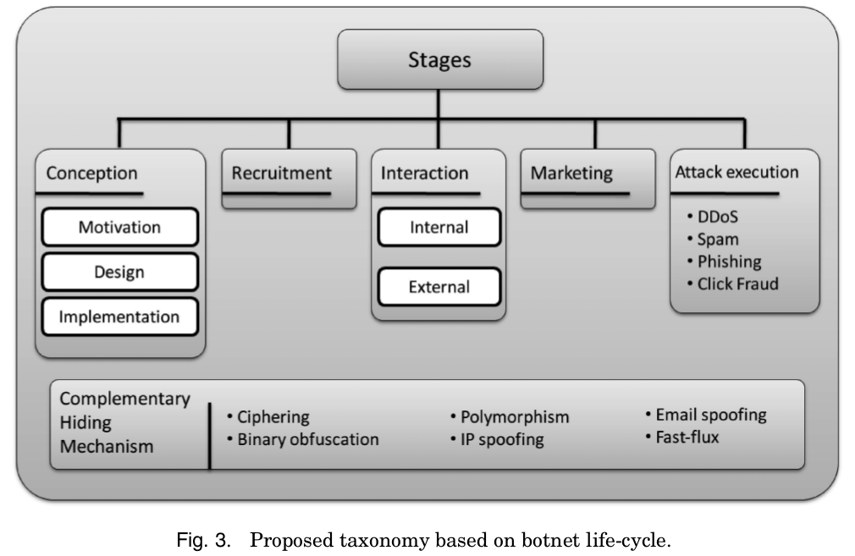
Botnet Lifecycle
http://sp4hack.blogspot.com/2014/02/botnet-life-cycle.html

Slide 4

Goals
Develop a proof-of-concept botnet detection mechanism using a clustering analysis of network flows based on basic knowledge of basic botnet behavior.
If possible the detection mechanism should not be dependent upon specific botnet signatures or architectures.
We will be using Metasploit to simulate malware behavior and it will be used to exploit a system on the network.

Slide 5
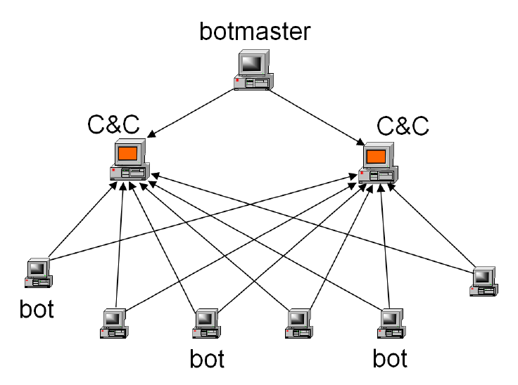
Botnet Architecture
Centralized Botnet Architecture (Command and Control):
Oldest and easiest architecture to manage & control botnets. All zombie computers is supervised from a center point.
https://www.usenix.org/legacy/event/hotbots07/tech/full_papers/wang/wang_html/

Slide 6
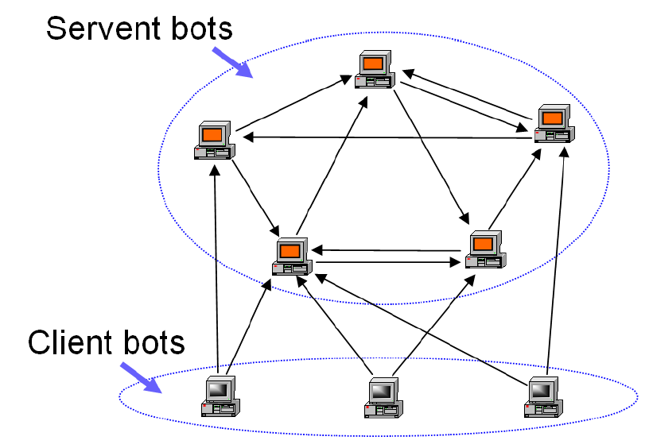
Peer to peer Botnet Architecture
This is was developed to remove the drawbacks of centralized architecture. In this architecture a node can act as a client (soldier bot) as well as a server (supervisor bot) and there is no centralized point as C&C server.
https://www.usenix.org/legacy/event/hotbots07/tech/full_papers/wang/wang_html/

Slide 7
DIFFICULTIES
Obtaining a malware/bot that communicates using a centralized communication structure-Zeus
Obtaining a malware/bot that communicates using a peer to peer communication structure-Nugache (P2P version of Zeus)
Finding an actual tool that will analyze the Wireshark traces to find out what malware/bot is running on the network.

Slide 8
SOLUTIONS/WORK AROUND
To simulate the bots/malware, we resulted to using Metasploit, which is a tool mainly used by penetration testers and Network Security Specialists for analyzing a network for vulnerabilities.
Using Snort for real time detection of the Metasploit attack.
For the Wireshark traces analysis, we resulted to analyzing the traces online using some online resources available on these websites;
https://www.virustotal.com/
https://www.networktotal.com/
https://malwr.com/

Slide 9






Tools/Software Used
VMWare
Windows XP SP1
Kali Linux
Apache Web Server
FTP Server
Wireshark
Snort
Metasploit

Slide 10
Network Setup
For this project, we will create a small and simple virtual network using VMWare. It will consist of three systems-
System 1- Windows XP installed, as well as FTP server and Apache web server installed. Wireshark and Snort will also be installed. This will serve as the target machine to be exploited by Metasploit.
System 2- Windows XP installed, but will serve as a FTP and HTTP client.
System 3- Kali Linux installed. This will be the attacker system and it will use Metasploit to attack system 1.

Slide 11
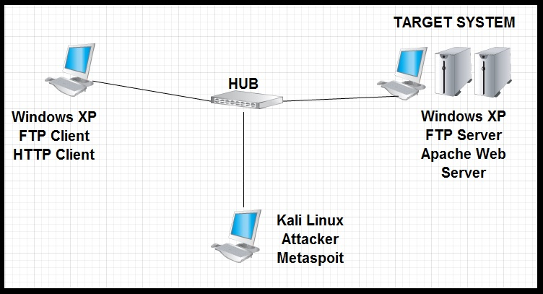
Diagrammatic Network Representation

Slide 12
Malware/Botnets to be used
For the purpose of this project, we will be making use of Metasploit, to infect our small network, in order to simulate malware behavior, and ultimately, an infected network.
Metasploit is a tool, mainly used by penetration testers and network security specialists to analyze a network for vulnerabilities that maybe exploited by a blackhat.
It is a tool for developing and executing exploit codes against a remote target machine.

Slide 13
IMPLEMENTATION OVERVIEW
First, we have all systems and network services up and running. Then we run Wireshark on the target system. Then, the other system on the network accesses the FTP and HTTP services on the target system, generating FTP and HTTP traffic, which is then captured by Wireshark, the trace is then saved. This serves as our clean trace, and our basis for analysis as the trace is obtained from a clean, uninfected network.
Then, with the FTP and HTTP traffic going on, Snort and Wireshark running, the attacker system exploits the target system, using Metasploit. Snort serving as an IDS, and also configured to detect Metasploit, will detect the exploit in real time. Network activities are also captured by Wireshark, the traces are saved and then analyzed for suspicious traffic, using the clean trace as a baseline.

Slide 14
Metasploit Attack
Before launching the attack, first we need to know certain information
Determine the Metasploit exploit to use
exploit/windows/smb/ms08_067_netapi- it is a critical vulnerability in the windows server service on windows 2008,xp,vista,2003 and 2000 computers, which allows the hacker to gain control of the system with the same privileges as the logged on user. We chose this exploit because Windows XP SP1 is vulnerable to this exploit.
Determine the Metasploit payload to use
windows/meterpreter/reverse_tcp
Determine both ip addresses of the localhost and remote host

Slide 15


Metasploit Attack Cont’d
First, it initiates a three way handshake with the target system, with a certain source port on the attacker system and a destination port on the remote system. After this is done, it creates a reverse TCP connection from the remote host back to attacker, using it to get pretty much any information it wants.
TCP THREEWAY HANDSHAKE
Attacker
Target
REVERSE TCP CONNECTION

Slide 16
Snort Real-Time Detection
After the installation and configuration of snort, for it to be able to detect Metasploit attacks in real time and alert and/or log the intrusion, we have to write our own snort rules. By default, without writing any rules, based on the exploit used, snort only detects the TCP three way handshake. We need our own rules to detect the reverse TCP connection. Example
|-------Rule Header-----------------|-----Rule Options---------------------|
Action protocol any any -> any any (msg,flags,seq,ack,content,ttl,dsize)
Actions-Alert, log, pass, activate Flags-SYN,ACK,URG,PSH,FIN,RST
Other protocols- TCP,UDP, IP, ICMP
Alert tcp 192.168.1.0/24 any -> any any (msg:”Port scan”; flags:SAFPU; sid:10001;)

Slide 17
PROJECT DELIVERABLES
Fall 2014 Semester
Get network up and running
Demonstration of successful exploitation of target system
Writing snort rules for real time Metasploit attack detection
Analyzing saved traces to obtain additional information not gotten from snort
Spring 2015 Semester
Reproducing the project using 4 physical machines.
Documentation of project implementation
Writing project research paper.

Slide 18
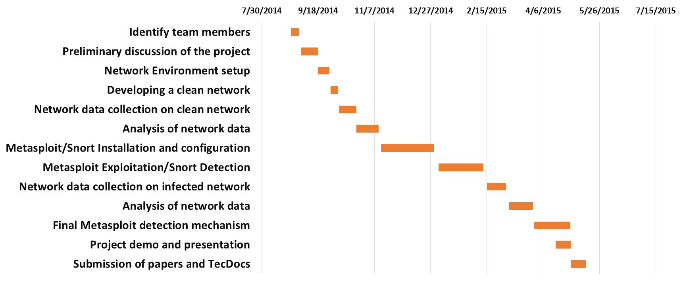
Gantt Chart

Slide 19
References
Gu, G. 2008. Correlation – based Botnet detection in enterprise networks. E-book. https://smartech.gatech.edu/bitstream/handle/1853/24634/gu_guofei_200808_phd.pdf;jsessionid=1BF7254B166631345295BD4A85E462F0.smart2?sequence=1.
Gu, G., Perdisci, R., Zhang, J., and Lee, W. BotMiner: Clustering Analysis of Network Traffic for Protocol- and Structure-Independent Botnet Detection. E-book. Available through https://www.usenix.org/legacy/event/sec08/tech/full_papers/gu/gu.pdf.
Zeidanloo, H.R., Manaf, A.B.A. 2010. Botnet Detection by Monitoring Similar Communication Patterns. (IJCSIS) International Journal of Computer Science and Information Security.
http://www.offensive-security.com/metasploit-unleashed/Main_Page
http://openmaniak.com/snort.php
https://www.wireshark.org/docs/wsug_html_chunked/ChapterIntroduction.html#ChIntroWhatIs

Slide 20
THANK
YOU

